Slide 1
Applied Data Science Capstone
Chee Loh
September 12, 2020

Slide 2
Predicting Traffic Accident Severity
Countless time, money, and public resources are spent during traffic accidents
By predicting the severity of any given traffic accident we can:
Reduce commute time by suggesting alternative driving routes
Reduce insurance costs and money spent on repairs and public restoration
Reduce valuable emergency service resources spent responding to traffic accidents
Improve traffic efficiency and everyday driving experience

Slide 3
Data Acquisition and Cleaning
Full data set imported from cloud storage on traffic accidents in Seattle from 2004 to 2020 - roughly 200k traffic incidents
After data set was imported using pandas read_csv(), significant information such as weather conditions, incident date and time, and severity code was extracted and stored into a new dataframe
Due to the large size of the data set, a sample of 50,000 incidents was taken randomly
Any blank information was filled in with “Unknown” for effective analysis

Slide 4
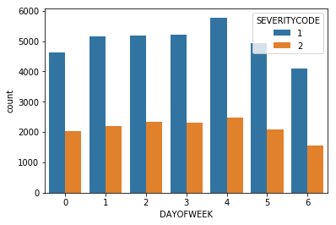
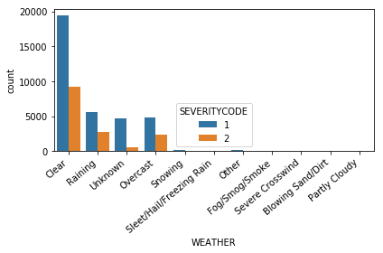
Exploratory Analysis
An initial exploratory analysis was performed on the extracted data to see if any interesting or valuable information could be produced
The graph on the left shows accident severity plotted against day of the week
The graph on the right shows accident severity plotted against weather conditions recorded

Slide 5
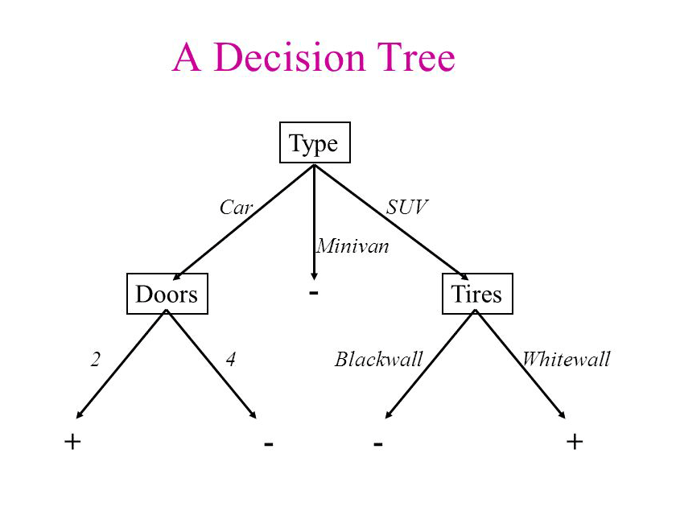
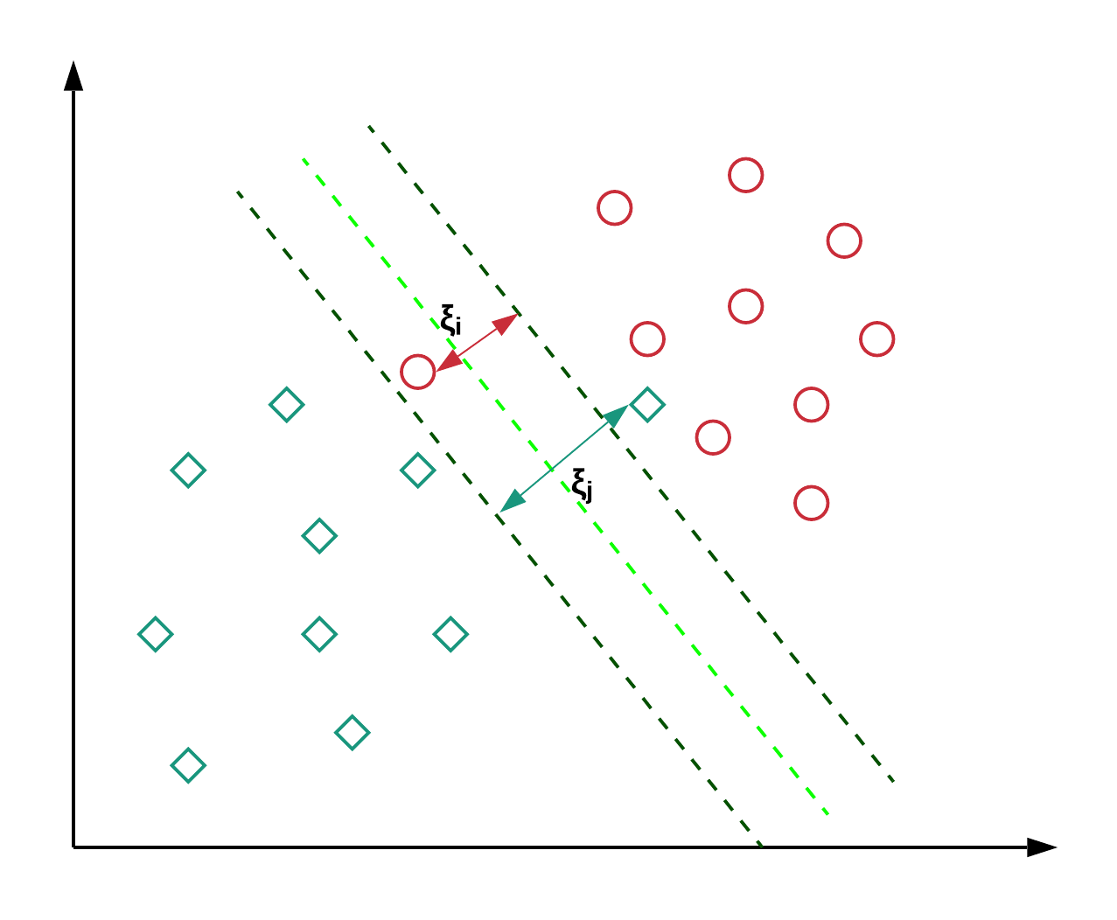
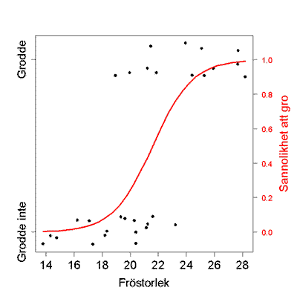
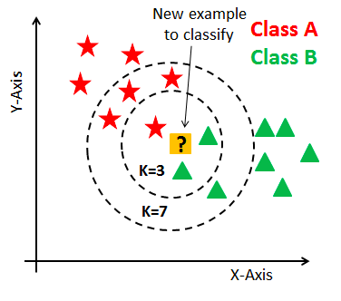
Analyzing Data with Classification Models
Four classification models were used in order to attempt to predict accident severity using weather features
These include K-Nearest Neighbor, Decision Tree, Support Vector Machine, and Logistic Regression

Slide 6

Analyzing the Results
The initial 50,000 sample dataset was split into a “training” set and “testing” set of data for each of the 4 models
Each model was fitted with the appropriate fit model and the Jaccard Accuracy Score and the F1 Accuracy Score was calculated for each model to evaluate performance
The SVM and Logistic Regression models had equivalent performance so best model could be chosen based on performance time or other factors

Slide 7
Conclusion and Future Work
This capstone gave valuable hands-on practice for creating prediction models using various algorithms and methods
Visualization of results and evaluation of accuracy and performance of each model also provided more learning experience
All models were unable to achieve a successful prediction rate >70% so more advanced or more appropriate models will need to be investigated
Future work could include also analyzing how other features of the dataset such as road conditions or light conditions impact accident severity

Slide 8
THANK YOU!

